Slide 1

ANALYSIS AND SOLUTION OF
LeetCode Qsn No 931
Madan Raj Upadhyay
RA2211003012077

Slide 2
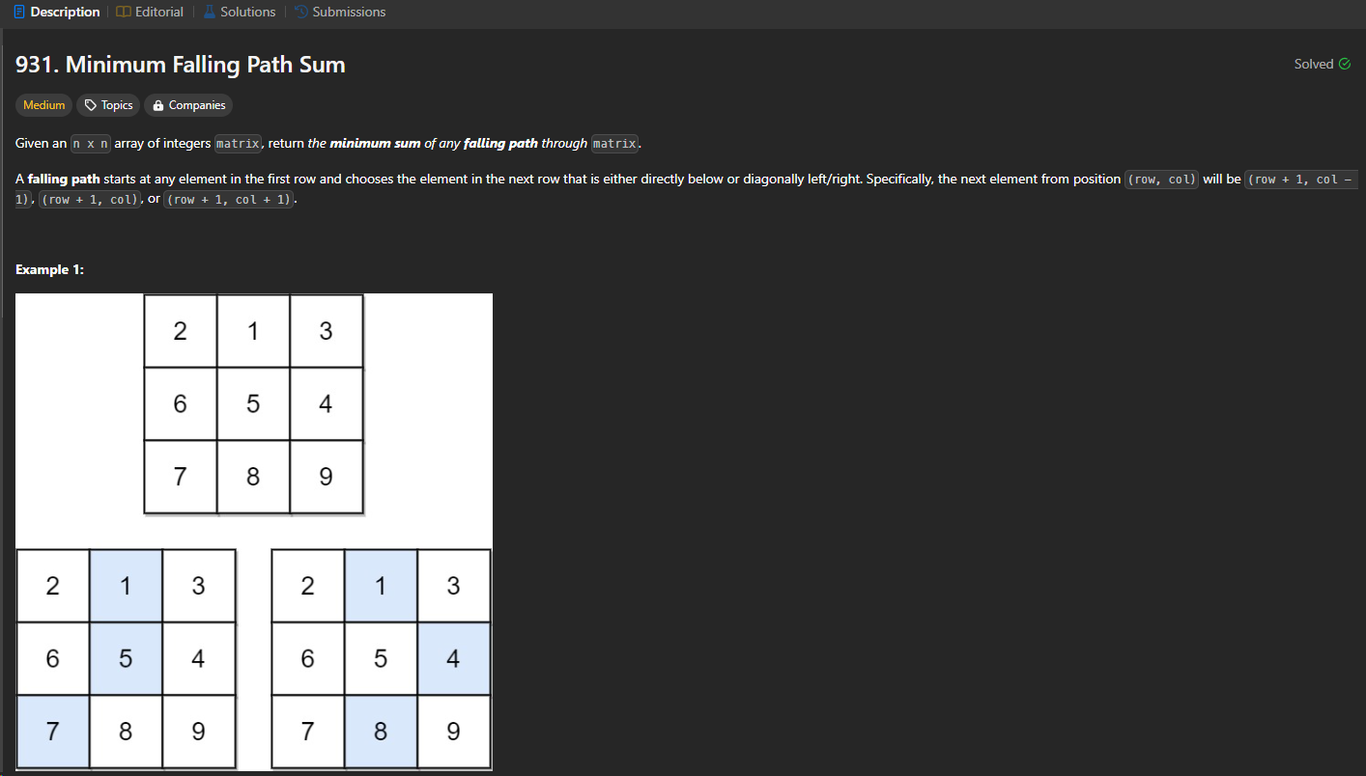
FOR EVERY ELEMENT WE HAVE 3 OPTIONS
GO STRAIGHT
GO LEFT
GO RIGHT
WE NEED TO FIND THE MINIMUM SUM FROM ALL POSSIBLE SOLUTIONS
THUS IT TAKE O(3^N) USING BRUTE FORCE
Which will give TLE

Slide 3
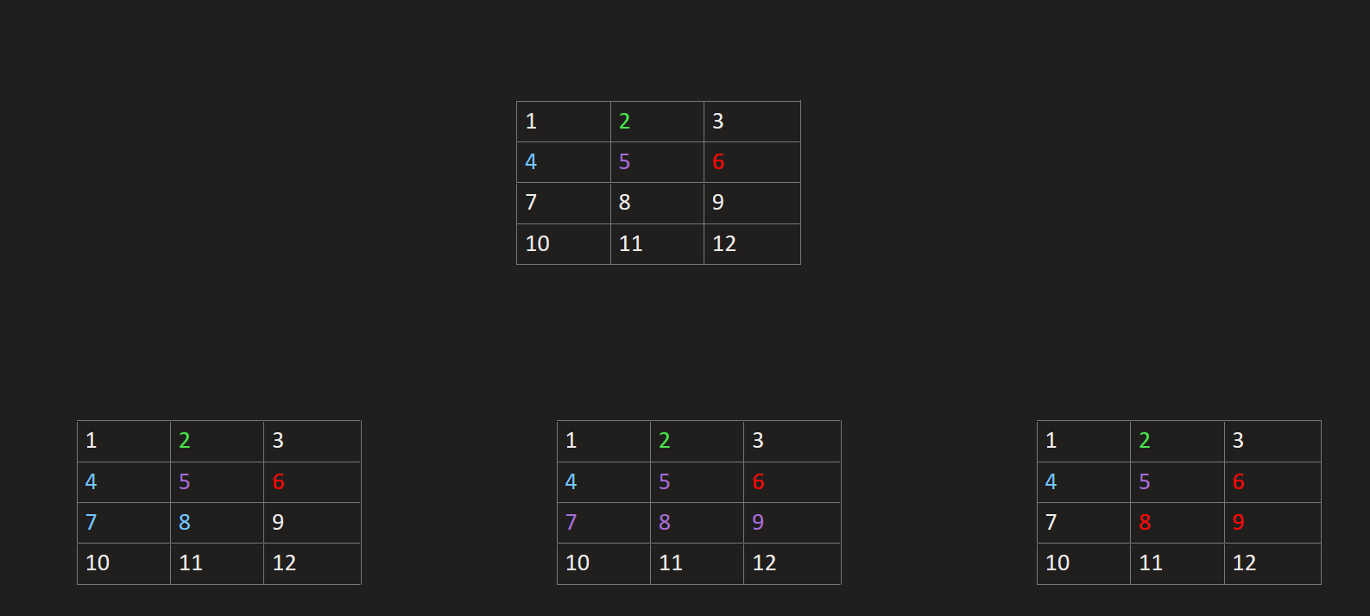
BRUTE FORCE APPROACH

Slide 4
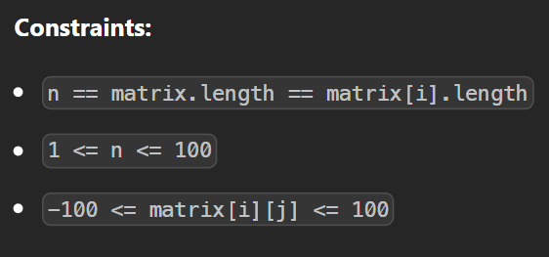
Lets Build Intuition for Better Approach
On Looking At The Constraints of the questions It suggest us to go maximum of O(N^2) beyond that it will give us TLE
Which is one of the best hint to find the solution
Here n ranges from 1 to 100 and matrix[i][j] ranges from -100 to 100
Thus we can go maximum upto O(N^2)

Slide 5

Now our task is to go for O(3^N)=>O(N^2)
We have one best approach which will reduce our Exponential complexity to linear or quad. Which is not other than DP
So The hint from constraints is more than enough to go for solution

Slide 6
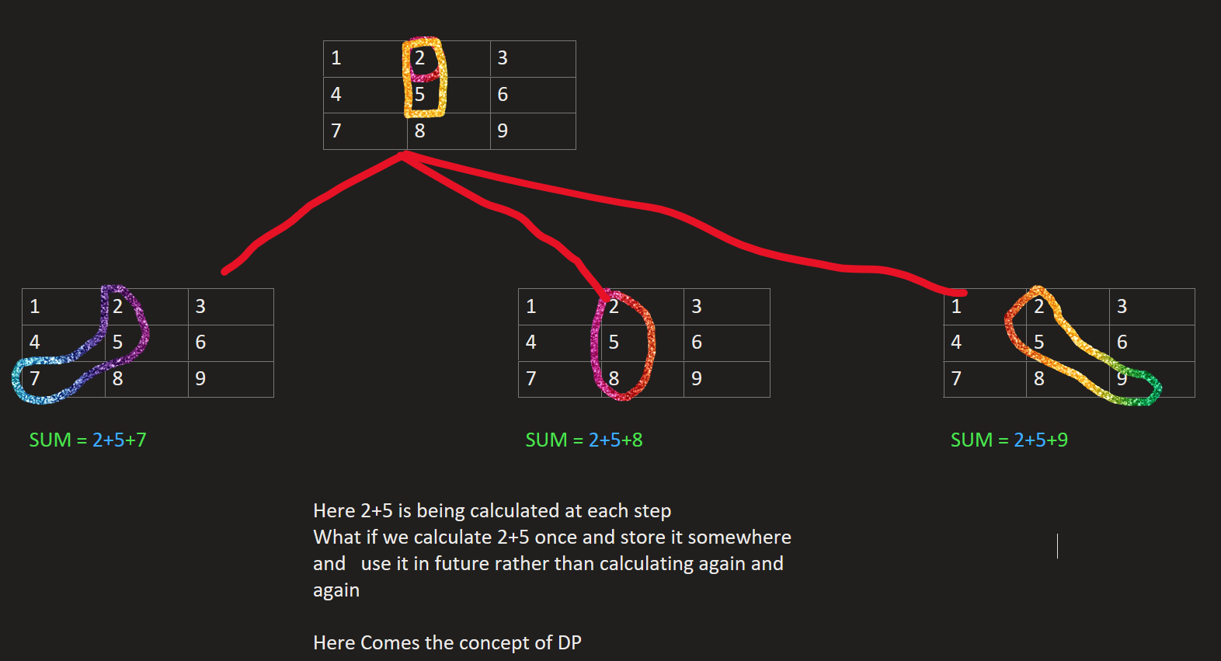

Slide 7
Lets Implement the concept of DP(memoization)
It mean we will create an 2D array and store the previously calculated result and use it when we need it in future , which reduces the calculation time
We will initialize whole array with -1 initially and when we calculate any result we will store it
After that if the value in array is not -1 then we will be sure that its already calculated so we will use that value

Slide 8
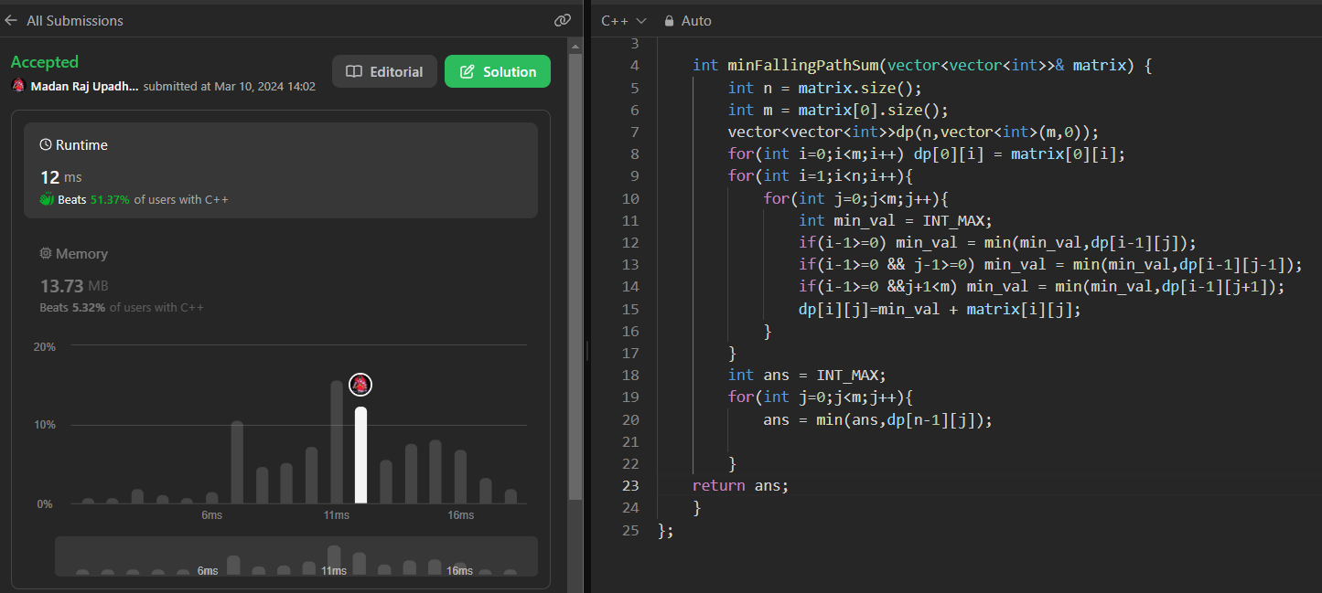
CODE

Slide 9
Can we again Optimize it??
Previously we are able to solve with time complexity of O(N^2)
And Also it is taking space complexity of O(N^2)
So Lets optimize its space complexity

Slide 10
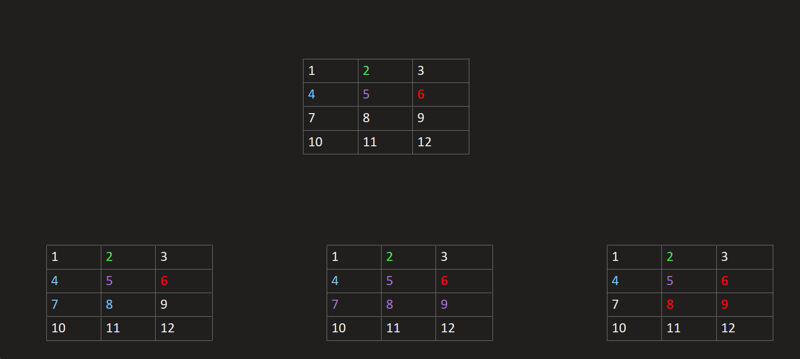










Here the current element is only dependent
On its previous row
Ie, 5 on 2
7 , 8, 9 on 5 and so on
So we only need to store previous row only
if(i-1>=0) min_val = min(min_val,dp[i-1][j]);
if(i-1>=0 && j-1>=0) min_val = min(min_val,dp[i-1][j-1]);
if(i-1>=0 &&j+1<m) min_val =
min(min_val,dp[i-1][j+1]);
Here we can see in code itself its dependent on dp[i-1]
For each case so we will work in this and optimize our
code

Slide 11
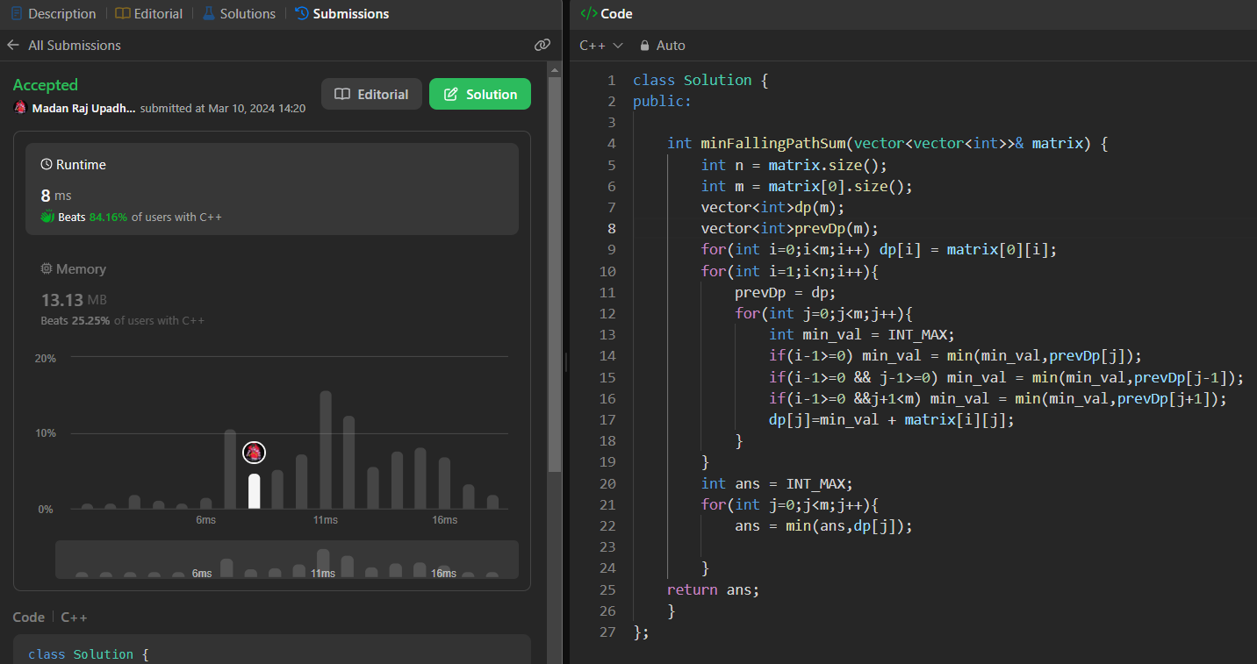
CODE

